Slide 1
Scrambling
Use scrambling to replace sequences that would produce constant voltage
Filling sequence
Must produce enough transitions to sync
Must be recognized by receiver and replace with original
Same length as original
No dc component
No long sequences of zero level line signal
No reduction in data rate
Error detection capability

Slide 2
B8ZS
Bipolar With 8 Zeros Substitution
Based on bipolar-AMI
If octet of all zeros and last voltage pulse preceding was positive encode as 000+-0-+
If octet of all zeros and last voltage pulse preceding was negative encode as 000-+0+-
Causes two violations of AMI code
Unlikely to occur as a result of noise
Receiver detects and interprets as octet of all zeros

Slide 3
HDB3
High Density Bipolar 3 Zeros
Based on bipolar-AMI
String of four zeros replaced with one or two pulses

Slide 4
HDB3 Rules

Slide 5
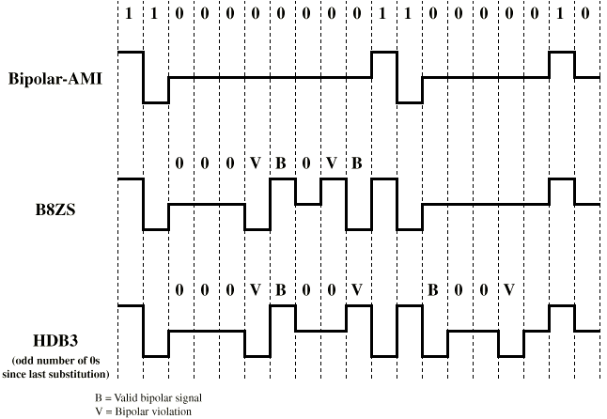
B8ZS and HDB3

Slide 6
Digital data, Analog signals

Slide 7
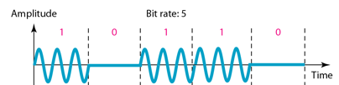

Binary amplitude shift keying

Slide 8
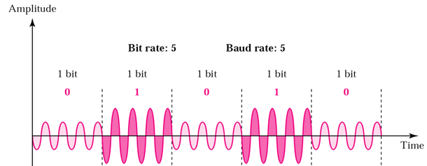
Binary amplitude shift keying

Slide 9
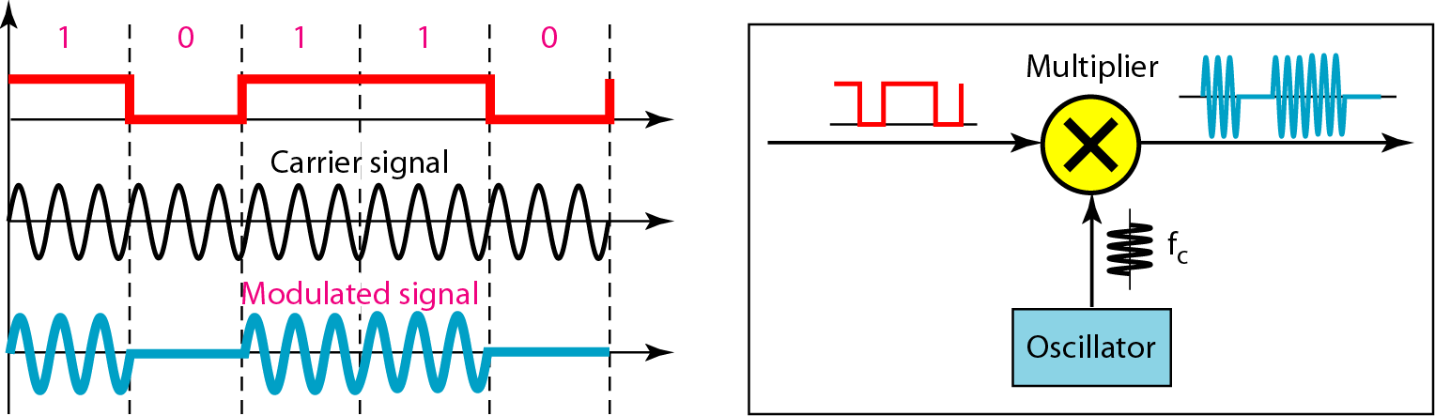
Implementation of binary ASK

Slide 10
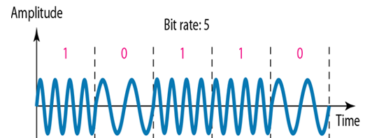

Binary frequency shift keying
f2
f1

Slide 11
Multiple FSK (MFSK)
More than two frequencies (M frequencies) are used
More bandwidth efficient compared to BFSK
More susceptible to noise compared to BFSK

Slide 12
MFSK signal:
11
10
01
00
Ts
L=2
M=4
Minimum frequency separation 2fd=1/Ts
2fd
Bandwidth=2Mfd=M/Ts
Notes:
Refer slide 17 the Gap between the lines(frequencies )must be 2fd

Slide 13
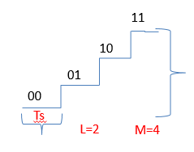
MFSK signal:
Period of signal element
Minimum frequency separation
MFSK signal bandwidth:

Slide 14
MFSK frequency use

Slide 15
Example
Given a bandwidth of 10,000 Hz (1000 to 11,000 Hz), draw the full-duplex FSK diagram of the system. Find the carriers and the bandwidths in each direction. Assume there is no gap between the bands in the two directions.

Slide 16
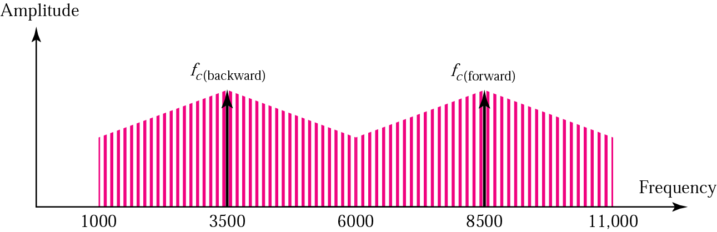
For full-duplex FSK, the bandwidth for each direction is
BW = 10000 / 2 = 5000 Hz
The carrier frequencies can be chosen at the middle of each band
fc (backward) = 1000 + 5000/2 = 3500 Hz
fc (forward) = 11000 – 5000/2 = 8500 Hz

Slide 17
Example
With f_{c}=250KHz, f_{d}=25KHz, and M=8 (L=3 bits), we have the following frequency assignment for each of the 8 possible 3-bit data combinations: Find BW and data rate.

Slide 18
This scheme can support a data rate of:

Slide 19
Example
We need to send data 3 bits at a time at a bit rate of 3 Mbps. The carrier frequency is 10 MHz. Calculate the number of levels (different frequencies), the baud rate, and the bandwidth.

Slide 20
We can have L=3,M = 2³ = 8.
The baud rate is D=R/L
D= 3 Mbps/3 = 1 Mbaud.
The bandwidth is :
T_{b}=Bit period=1/3 micro sec
TS=LT_{b}=3*(1/3) =1 micro sec
2fd=1/TS =1MHz
Bandwidth=8MHz
Tb=Ts/L
Ts=1/Baud Rate

Slide 21
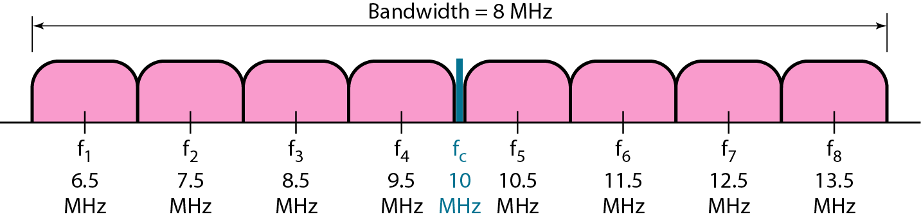

Slide 22
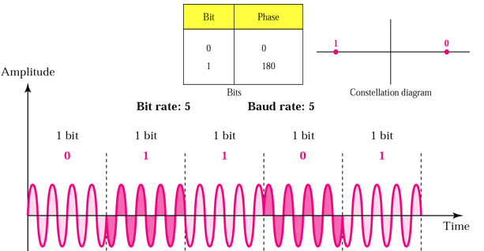
Phase Shift Keying

Slide 23
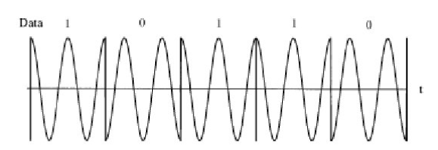


Slide 24
Phase of the carrier is varied to represent digital data (binary 0 or 1)
Amplitude and frequency remains constant.
If phase 0 deg to represent 0, 180 deg to represent 1. (2level-PSK)
PSK is not susceptible to noise degradation that affects ASK or bandwidth limitations of FSK.

Slide 25
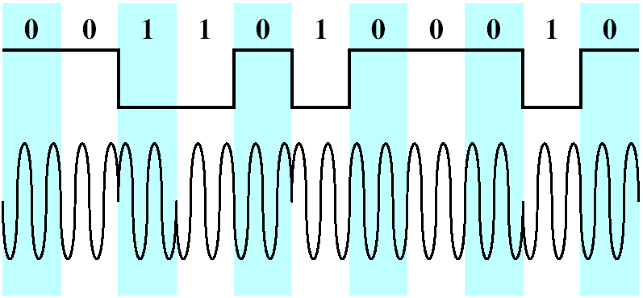
Differential PSK (DPSK)
In DPSK, the phase shift is with reference to the previous bit transmitted rather than to some constant reference signal
Binary 0:signal burst with the same phase as the previous one
Binary 1:signal burst of opposite phase to the preceding one

Slide 26
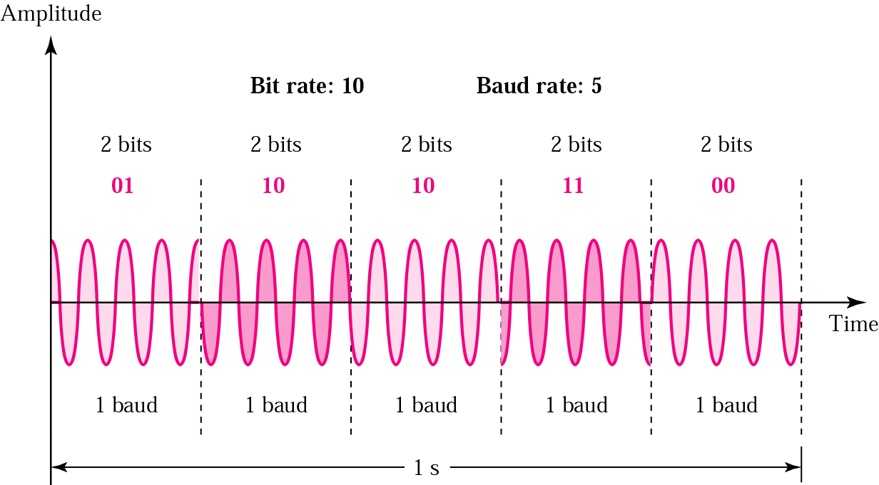
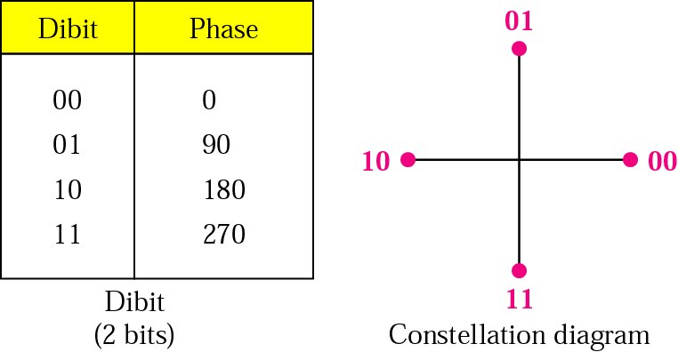
4-PSK (Quadrature PSK) method

Slide 27
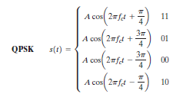

Slide 28
Quadrature PSK
To increase the bit rate, we can code 2 or more bits onto one signal element.
In QPSK, we parallelize the bit stream so that every two incoming bits are split up and PSK a carrier frequency. One carrier frequency is phase shifted 90º from the other - in quadrature.
The two PSKed signals are then added to produce one of 4 signal elements. L = 4

Slide 29
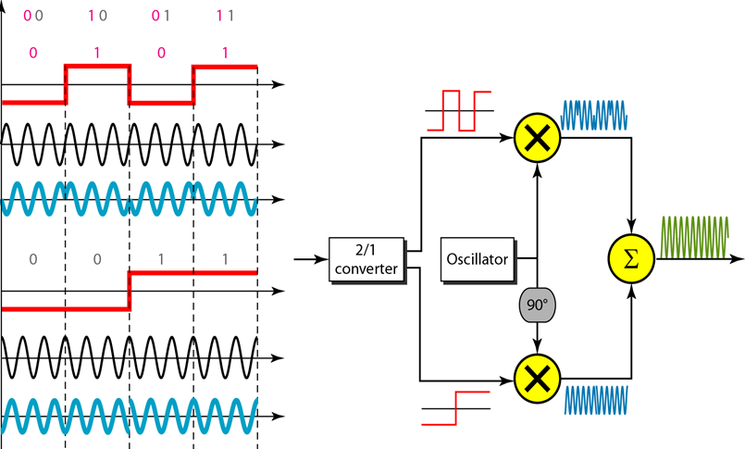

Slide 30
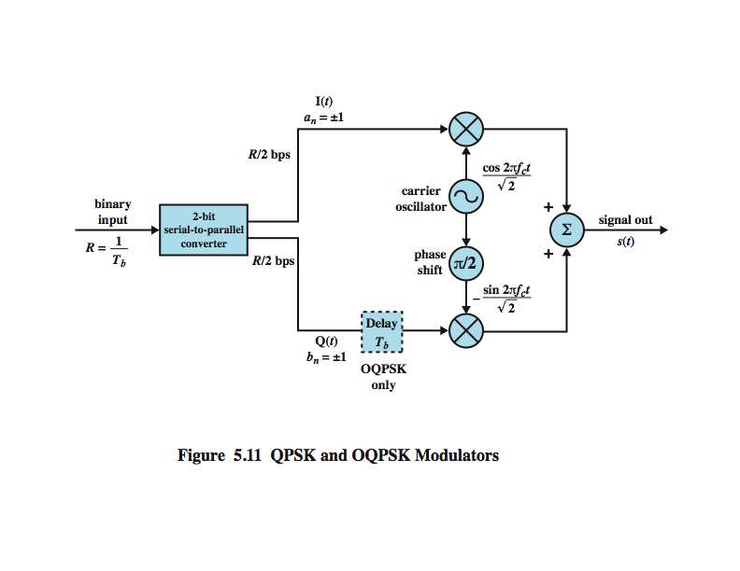
QPSK and Offset QPSK (OQPSK) Modulators

Slide 31
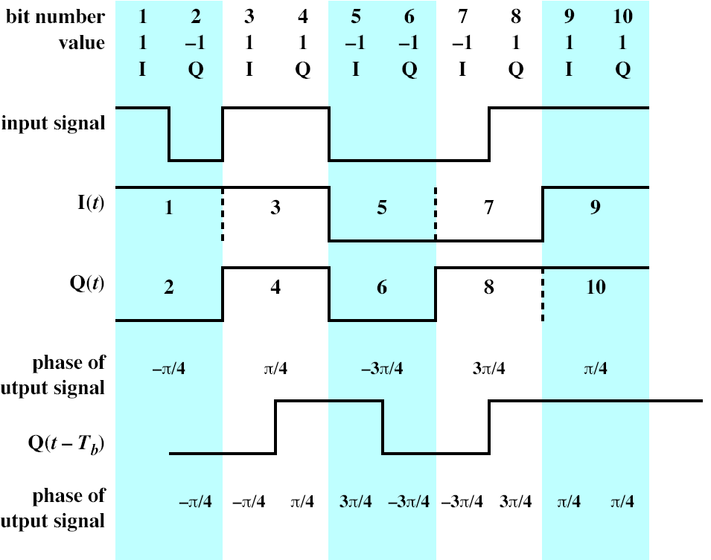

Slide 32
Transmission bandwidth BT for ASK, PSK and FSK is of the form
BT =(1+r)R
R- Bit rate
r- Related to technique typically 0<r<1

Slide 33
Performance
Bandwidth Efficiency
ASK/PSK/FSK:

Slide 34
Example
We have an available bandwidth of 100 kHz which spans from 200 to 300 kHz. What should be the carrier frequency and the bit rate if we modulated our data by using FSK with r = 1?

Slide 35
The midpoint of the band is at 250 kHz. B=100KHz, r=1
BT=(1+r)R
100=2R
R=100/2=50kbps

Slide 36
Example
We have an available bandwidth of 100 kHz which spans from 200 to 300 kHz. What are the carrier frequency and the bit rate if we modulate our data by using ASK with r= 1
BT=(1+r)R

Slide 37
Quadrature Amplitude Modulation (QAM)
QAM used on asymmetric digital subscriber line (ADSL) and some wireless standards
combination of ASK and PSK
logical extension of QPSK
send two different signals simultaneously on same carrier frequency
use two copies of carrier, one shifted by 90°
each carrier is ASK modulated

Slide 38
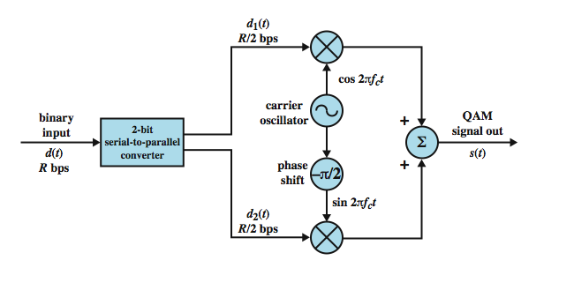
QAM modulator

Slide 39
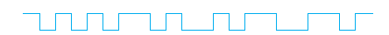
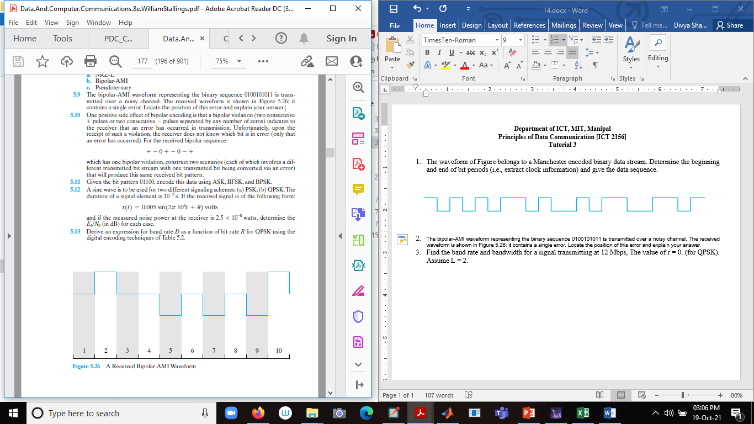
Tutorial
1. The waveform of Figure belongs to a Manchester encoded binary data stream. Determine the beginning and end of bit periods (i.e., extract clock information) and give the data sequence.
2. The bipolar-AMI waveform representing the binary sequence 0100101011 is
transmitted over a noisy channel. The received waveform is shown in Figure it contains a single error. Locate the position of this error and explain your answer.

Slide 40
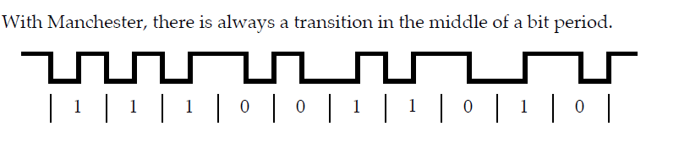
1.

Slide 41
2. The error is at bit position 7, where there is a negative pulse. For AMI, positive and negative pulses are used alternately for binary 1. The pulse in position 1 represents the third binary 1 in the data stream and should have a positive value.

Slide 42
3. One positive side effect of bipolar encoding is that a bipolar violation (two consecutive + pulses or two consecutive - pulses separated by any number of zeros) indicates to the receiver that an error has occurred in transmission. Unfortunately, upon the receipt of such a violation, the receiver does not know which bit is in error (only that an error has occurred). For the received bipolar sequence + - 0 + - 0 - + which has one bipolar violation, construct two scenarios (each of which involves a different transmitted bit stream with one transmitted bit being converted via an error) that will produce this same received bit pattern.

Slide 43
3.
+-0+-0-+
a. +-0+-+-+
b. +-0+00-+
c. +-0+-00+

Slide 44
Assume that a telephone line channel is equalized to allow bandpass data transmission over a frequency range of 600 to 3000 Hz. The available bandwidth is 2400 Hz. For r=1, evaluate the required bandwidth for 2400 bps QPSK

Slide 45
